Slide 1






Seamless Connectivity Across Heterogeneous wireless Networks

Slide 2
Group Member’s
Kolli sai sriram reddy (AP20110010008)
Thadimarri Sameer (AP20110010028)
Bandapu Karthik reddy (AP20110010068)
Aravapalli Prahas (AP20110010436)
Under the Guidance of
Dr. Ajay Bhardwaj

Slide 3

Table of contents
Project Introduction
Methodology & Implementation
01
02
Conclusion & Future Works
03
04
References

Slide 4
Project Introduction
01
The Role of Heterogeneous Wireless Networks

Slide 5

Abstract
Heterogenous Wireless Networks refers to a network architecture that integrates different types of wireless networks, such as cellular networks, Wi-Fi, satellite communication, and Bluetooth, into a single integrated system. This integration allows for more efficient use of resources, improved coverage, and enhanced connectivity speeds.
This integrated system enable devices to switch between different types of networks without any effort, ensuring that users always have the best possible connection based on their location a the network conditions. The concept of Heterogenous wireless networks also plays key role in development of next-generation wireless technologies(Such as 5G).

Slide 6
Heterogeneous wireless Networks
Types
Important Features
Cellular Networks
Quality of Service (QoS)
Wi-Fi Networks
Scalability, Flexibility &
Cost Saving
Ex – LTE, 5G, Wi-Fi
Enhanced User Experience

Slide 7
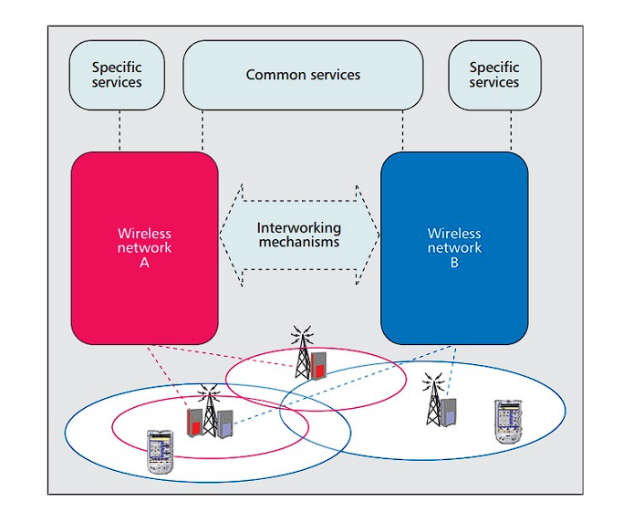
Internetworking
This diagram illustrates the integration of two distinct wireless networks, labeled Wireless Network A and B. Each network offers unique services, connected through interworking mechanisms that facilitate shared common services. The overlapping coverage areas demonstrate the seamless connectivity between these networks, ensuring comprehensive service provision across different zones.

Slide 8
Parameters in HWNs
Parameters | Description
Signal Strength | Measures the quality of the Network Signal
Network Congestion | Indicates the level of Traffic in a Network
User Mobility | User’s speed and Direction of Movement
Service Type | Type of service required (e.g., voice, data)
Cost | The expense associated with using the network
Battery Level | Current battery status of the user device (Energy Efficiency)

Slide 9



Mechanisms for Efficient Communication
Resource Allocation
Network
Selection
Load
Balancing
Enables the selection of best network for the seamless transfer of data
Dynamically allocate network resources to meet the user demands.
Distributes network traffic evenly across all network types to prevent overloading

Slide 10



Mechanisms for Efficient Communication
Quality of Service (QoS)
Energy Efficiency Management
Security
Protocols
Prioritizes network traffic to ensure important applications receive the bandwidth and speed for optimal performance
Reducing the power consumption of network devices and operations while maintaining performance and service quality
Addressing the diverse security challenges of integrating multiple networks types, data integrity etc.

Slide 11
Methodology & Implementation
02
Practical Strategies for Heterogeneous Wireless Networks

Slide 12
Network Selection in HWNs

Slide 13



HWNs Network Selection
Inputs / Network Characteristics:
delay(ms): Time taken for data packets to travel from source to destination.
jitter(ms): Variation in packet delay caused by network conditions.
packLoss(%): Percentage of transmitted packets that fail to reach destination.
monetary(Rs/GB): Cost expenses associated with network usage.
Output/Ranking:
Ranks are alloted for each network and the network with highest Rank is selected as the best network.

Slide 14
What is AHP and Fuzzy logic?
The Analytic Hierarchy Process (AHP) is a step-by-step method for making complex decisions, especially those involving multiple attributes. It helps us organize and analyze these factors to arrive at a well-informed choice.
Fuzzy Logic offers a different approach to decision-making, particularly helpful for situations with uncertainty and ambiguity. Unlike traditional boolean logic that deals in absolutes (true or false), fuzzy logic uses degrees of truth or in-between values.

Slide 15
HWNs Network Selection Using Fuzzy Logic
This method uses Fuzzy Inference System (FIS) which involves:
Fuzzification: Converts crisp inputs into fuzzy sets using membership functions.
Knowledge/Rule Base: Comprises linguistic rules defining relationships between inputs and outputs.
Inference Engine: Processes fuzzy rules to determine the system's output.
The output of above FIS is considered as Quality index (QI) of each network and this is used for Ranking the networks, highest QI is chosen.
sample rules:
If delay is low and jitter is low and packLoss is low and monetary is low then QI is excellent.
If delay is low and jitter is low and packLoss is low and monetary is high then QI is great.

Slide 16
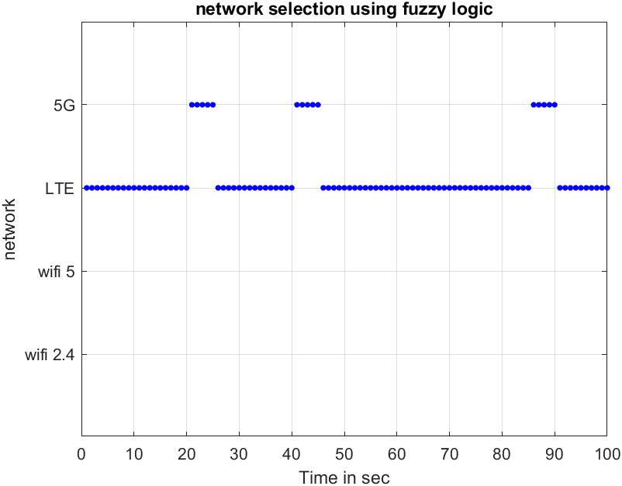
Result of Fuzzy Method

Slide 17
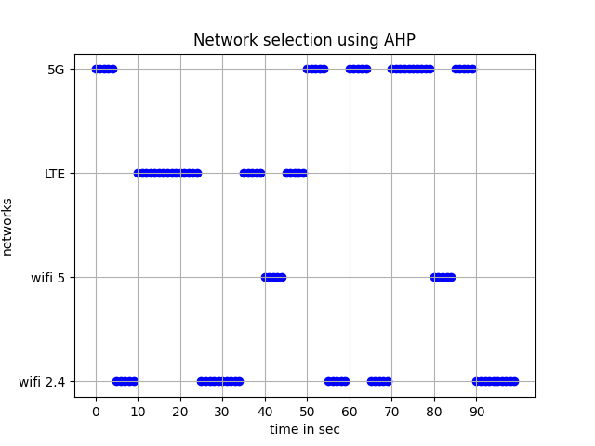
Network selection in existing AHP method

Slide 18
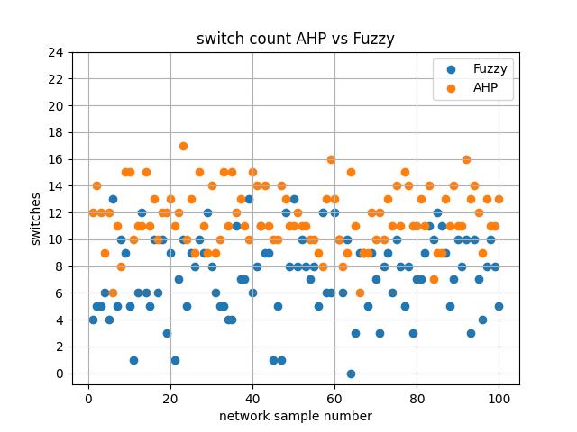
Fuzzy logic vs Analytic Hierarchy Process (AHP)

Slide 19
Energy-Efficient Resource Allocation in HWNs

Slide 20
To Simulate Energy-Efficient Resource Allocation in HWNs we have used “MATLAB”. Simulation Parameters – % Simulation parameters numAPs = 5; % Number of Access Points numUEs = 10; % Number of User Equipment's maxIterations = 100; % Initialize random system parameters powerAPs = 10 * rand(numAPs, 1); % Maximum power available at each AP bandwidths = randi([5, 20], numAPs, 1); % Bandwidths available at each AP userRequirements = randi([1, 5], numUEs, 1); % Data rate requirements for each UE Energy Efficiency Formula –

Slide 21
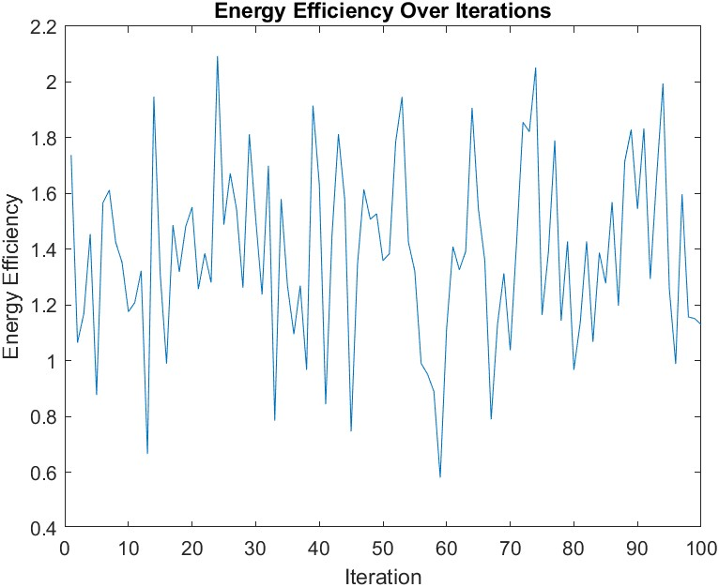
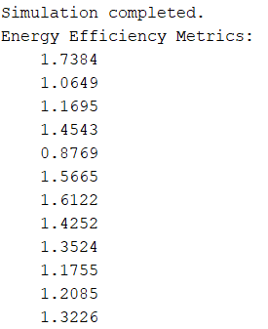
Standard Energy-Efficient Resource Allocation -

Slide 22
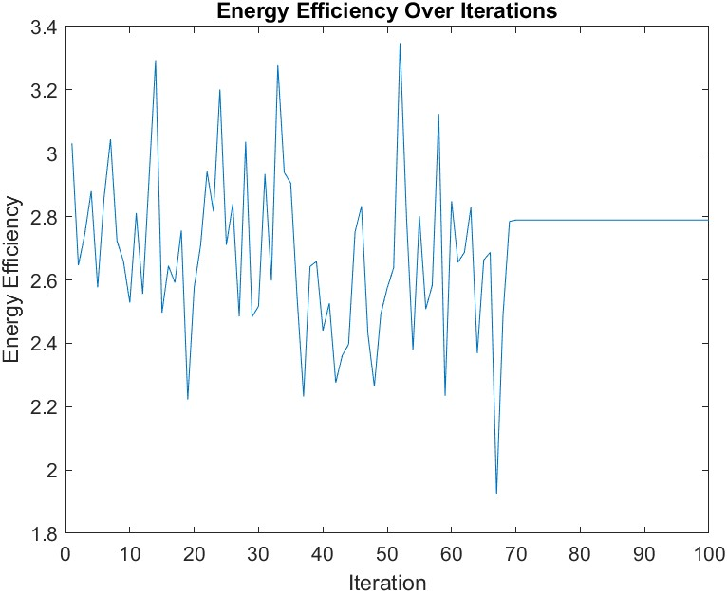

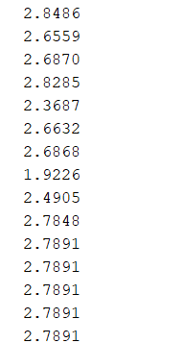
Energy-Efficient Resource Allocation with Feedback Mechanism (Our Implementation) -

Slide 23
Energy-Efficient Resource Allocation with Feedback Mechanism (Our Implementation) -
The simulation aims to optimize the energy efficiency of communication between Access Points (APs) and User Equipment's (UEs) in a network over 100 iterations.
The simulation incorporates a mechanism to detect when the energy efficiency has stabilized (changes less than 0.01 between iterations), at which point it locks in the optimal configuration.
The allocation allows for resource adjustments unless an optimum configuration is detected, improving adaptability and responsiveness to network conditions.
Once an optimum efficiency level is reached, further iterations do not adjust the resources, maintaining stable efficiency levels.
Stabilization of System Performance, Prevention of Frequent Reconfigurations, Resource Conservation, Reduced Operational Costs.

Slide 24
Load Balancing in Heterogeneous Wireless Networks

Slide 25
To Simulate Load Balancing in HWNs we have used “MATLAB”. Simulation Parameters – % Number of access points and devices numAPs = 5; % Number of Access Points numDevices = 50; % Number of Devices
Objective - To distribute the network load effectively among multiple Access Points (APs) in a wireless network by assigning devices to the nearest available AP.
The simulation involves 5 Access Points (APs) and 50 user devices distributed randomly within a defined two-dimensional area.
Each AP has a fixed capacity to handle up to 15 devices.

Slide 26
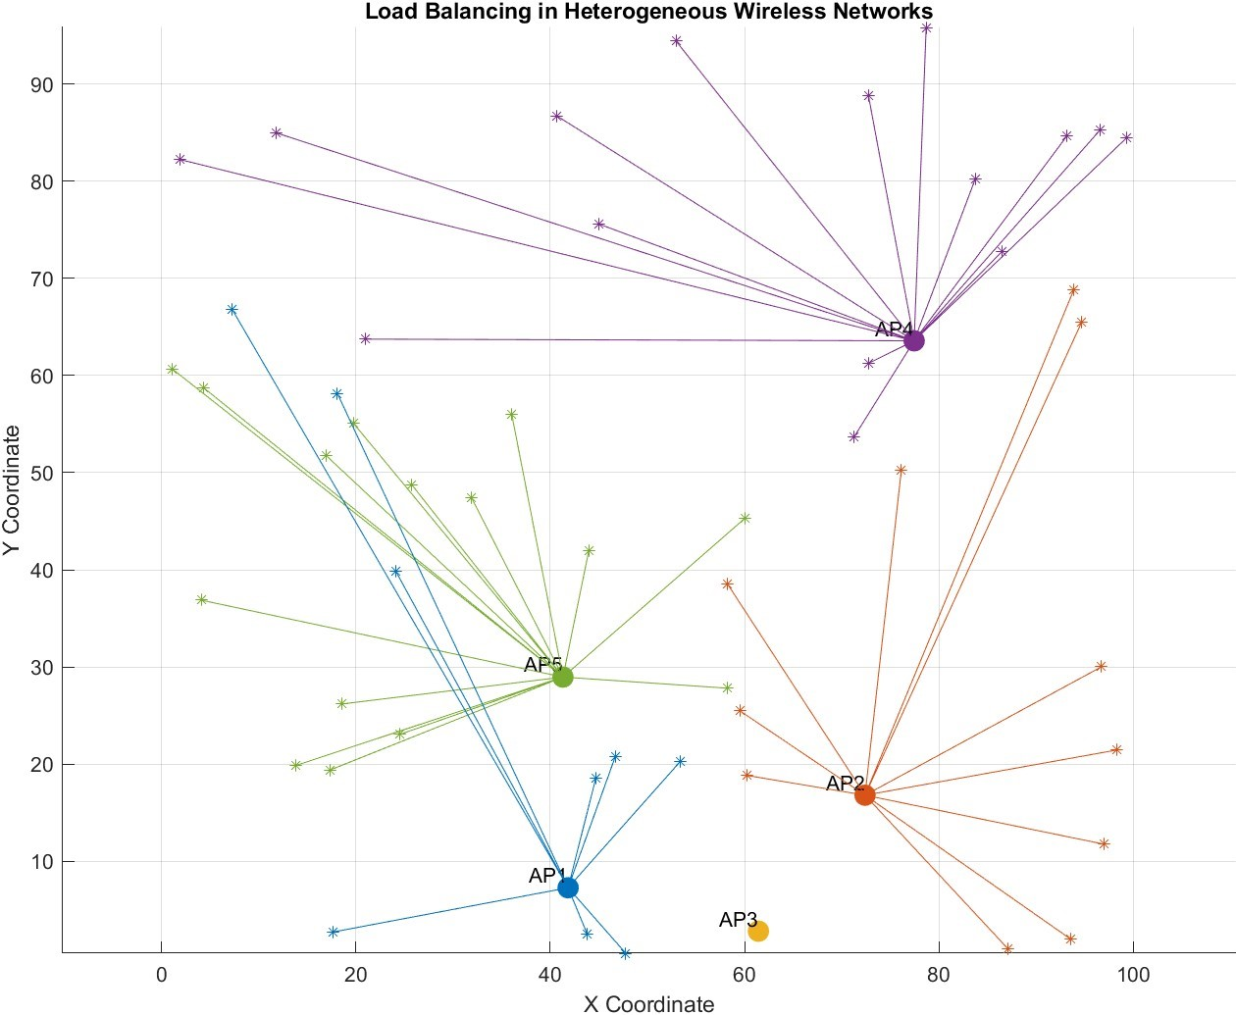
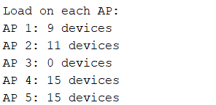

For each device, calculate the Euclidean distance to all APs to determine proximity.
Devices are iteratively assigned to the closest AP with remaining capacity, promoting an even distribution of devices across the network. Devices are assigned to the nearest AP with available capacity, ensuring that no AP is overloaded beyond its set capacity.

Slide 27
Load Balancing Mechanisms
Least Connections
Least Time to Respond
Assigns devices to APs with fewest connections.
Prevents overloading, ensures even load distribution.
Enhances network reliability and operational stability.
Prioritizes APs with fastest response times.
Ideal for demands of rapid data processing.
Optimizes network for performance-critical applications.

Slide 28
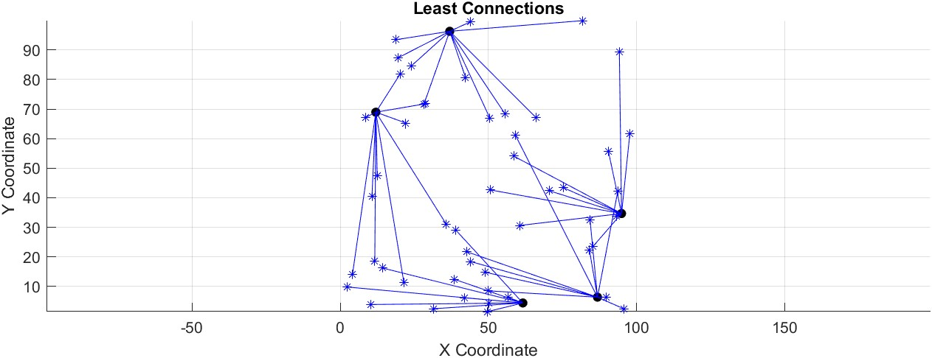
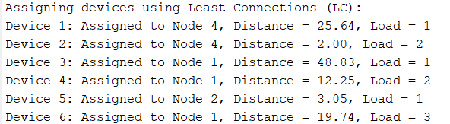
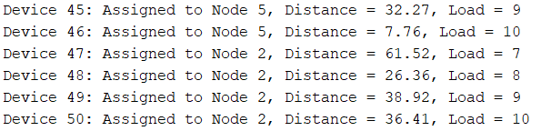

Slide 29
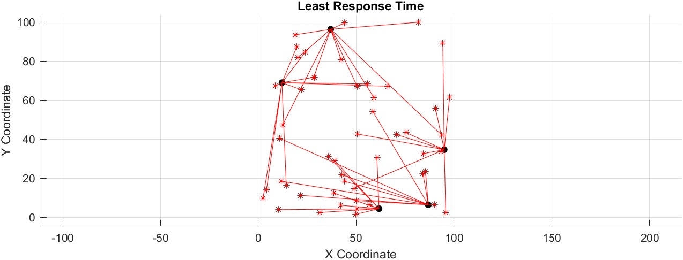
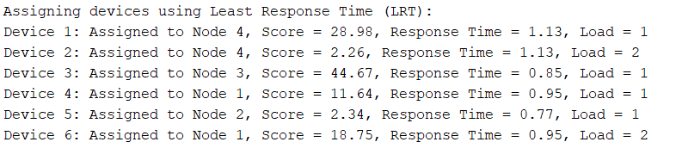
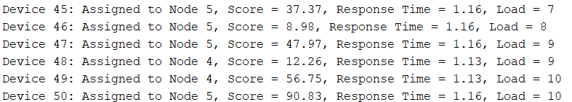

Slide 30
The simulation involves 5 nodes and 50 devices, randomly positioned within a 100x100 unit grid. The simulation involves 5 Access Points (APs) and 50 user devices distributed randomly within a defined two-dimensional area.
Maximum Limit for AP’s is 10 (Devices)
Nodes start with zero connections, and each node is assigned a random response time between 0.5 and 1.5 seconds.
The Euclidean distance between each device and all nodes is calculated to establish proximity.
For LC, distances are adjusted by adding a small value proportional to the current load on each node. For LRT, distances are multiplied by the node's response time to find the optimal node for connection.

Slide 31
Security in Heterogeneous Wireless Networks

Slide 32
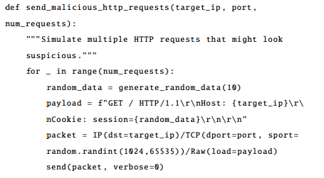
To Simulate the Security in Heterogeneous wireless Networks we have used Kali Linux, Wireshark and Simulation Using Python (Scapy Library)
Generating Malicious HTTP Request -
The script sends a series of HTTP GET requests to a specified target IP address. This type of activity can mimic behavior typical of reconnaissance attacks or attempts to exploit vulnerabilities in web application that might rely on cookie data.

Slide 33
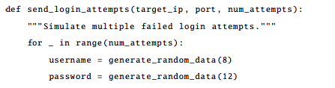
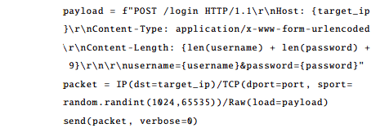
Simulating Login Attempts –
The script sends multiple HTTP POST request aimed at a login endpoint, attempting to simulate a brute-force attack where an threat actor tries various Username and Password combinations to gain unauthorized access.

Slide 34
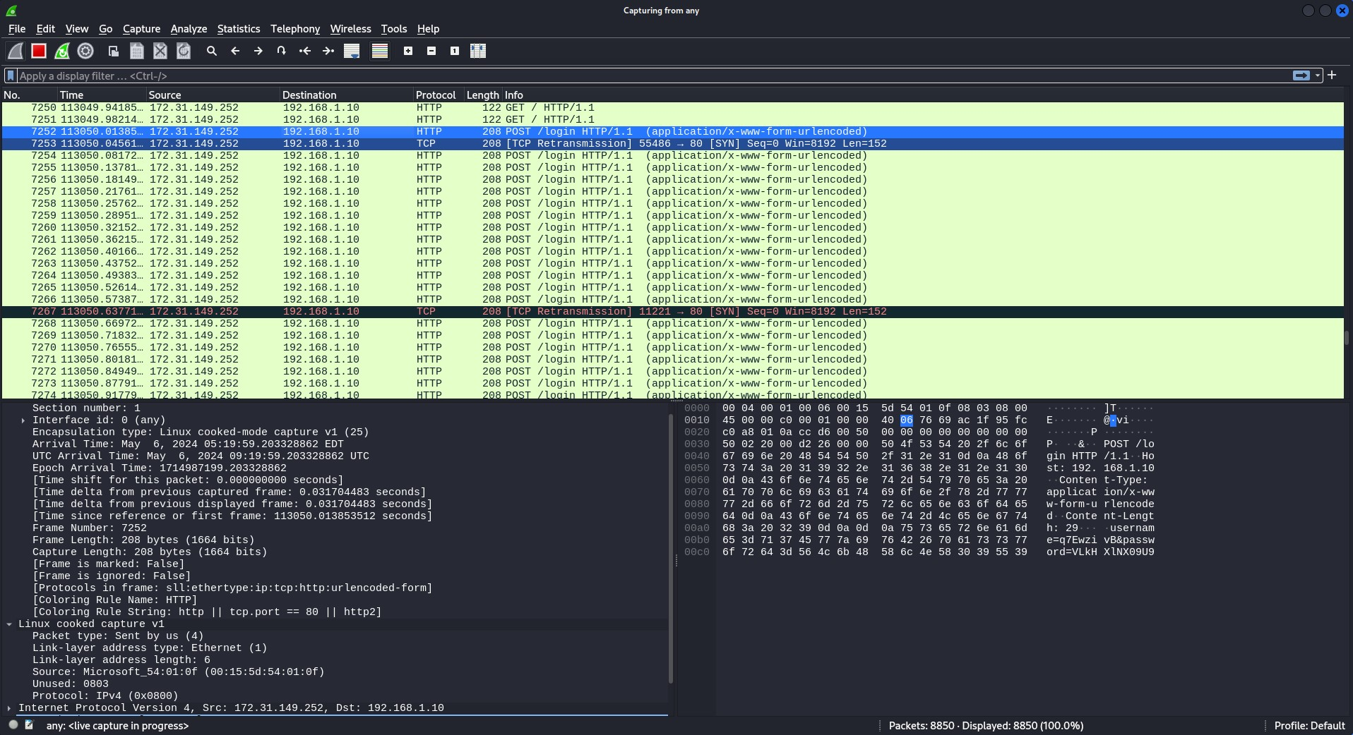
Malicious Traffic Captured by Wireshark –

Slide 35

Using Scapy Script to Block Malicious Traffic / Blocking Malicious Traffic –

Slide 36
Conclusion & Future Works
03
Prospects and Challenges

Slide 37



Introduction to Heterogeneous Wireless Networks and why it plays a key role in wireless technologies.
Fuzzy Logic in Heterogeneous Wireless Networks.
Comparision of Fuzzy Logic and Analytic Hierarchy Process (AHP) during network selection.

Slide 38
Energy-efficient resource allocation in Heterogeneous Wireless networks.
Covers why energy efficiency is important and the formula for calculating energy efficiency.
The parameters used for this simulation include number of access points and number of user equipment.
Standard Model vs Feedback Mechanism Model.

Slide 39
Load Balancing in Heterogeneous Wireless Networks.
Comparision of two distinct load balancing methods in a simulated network.
1) Least Connections (LC)
2) Least Time Response Time (LRT)
Optimized resource utilization and improved scalability.
Fault tolerant and high availability.

Slide 40
Security in Heterogeneous Wireless Networks.
Usage of tools like Wireshark to monitor the network for malicious activities.
Threat detection and mitigation .
We simulate a brute force attack to show how a threat actor might gain unauthorized access.

Slide 41
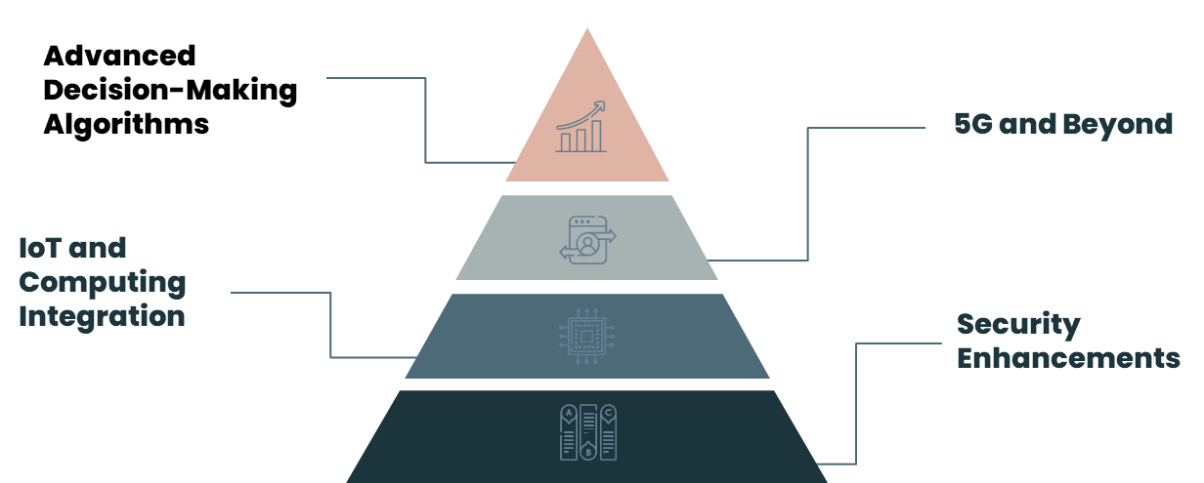
Future Works

Slide 42
References
04

Slide 43
R. Ferrus, O. Sallent, and R. Agusti, “Interworking in heterogeneous wireless networks: Comprehensive framework and future trends,” in IEEE Wireless Communications, no. 1, pp. 1-2, April 2010.
F. Bendaoud, M. Abdennebi, and F. Didi, “Network Selection schemes in Heterogeneous Wireless Networks,” Laboratory of Telecommunication Tlemcen (LTT), Technology’s Faculty, Tlemcen’s University, and Laboratory of Processing and Transmission of Information (L2TI), Physics Department, University of North Paris, 2023.
T. Sylla, L. Mendiboure, S. Maaloul, H. Aniss, M. A. Chalouf, and S. Delbruel, “Multi-Connectivity for 5G Networks and Beyond: A Survey,” in Sensors, vol. 22, pp. 1-32, October 2022.
C. Monteiro, V. Rios, and P. R. L. Gondim, “Use of Fuzzy Logic for Networks Selection in Heterogeneous Wireless Environment,” in Proceedings of the International Conference on Advanced Communication Technology (ICACT), February 2012.
R. Liu, M. Sheng, and W. Wu, “Energy-Efficient Resource Allocation for Heterogeneous Wireless Network With Multi-Homed User Equipments,” IEEE Access, 2018.
Y. Zhang, J. Chen, and X. Wang, “Security-Aware Cross-Layer Resource Allocation,” IEEE Transactions on Mobile Computing, 2023.

Slide 44
A. Monteiro, E. Souto, R. Pazzi, and M. Nogueira, “Context-aware network selection in heterogeneous wireless networks,” Computer Communications, vol. 135, pp. 1–15, 2019
F. Bari and V. Leung, “Automated Network Selection in a Heterogeneous Wireless Network Environment,” IEEE Network, vol. 21, no. 1, pp. 34–40, 2007.
M.I. Goh, A.I. Mbulwa, H.T. Yew, A. Kiring, S.K. Chung, A. Farzamnia, A. Chekima, and M.K. Haldar, “Handover Decision-Making Algorithm for 5G Heterogeneous Networks,” Electronics, 2023
Shobanraj Navaratnarajah, Arsalan Saeed, Mehrdad Dianati, and Muhammad Ali Imran, “Energy Efficiency in Heterogeneous Wireless Access Networks,” IEEE Access, 2013. 5

Slide 45
Thank You !!

